Slide 1
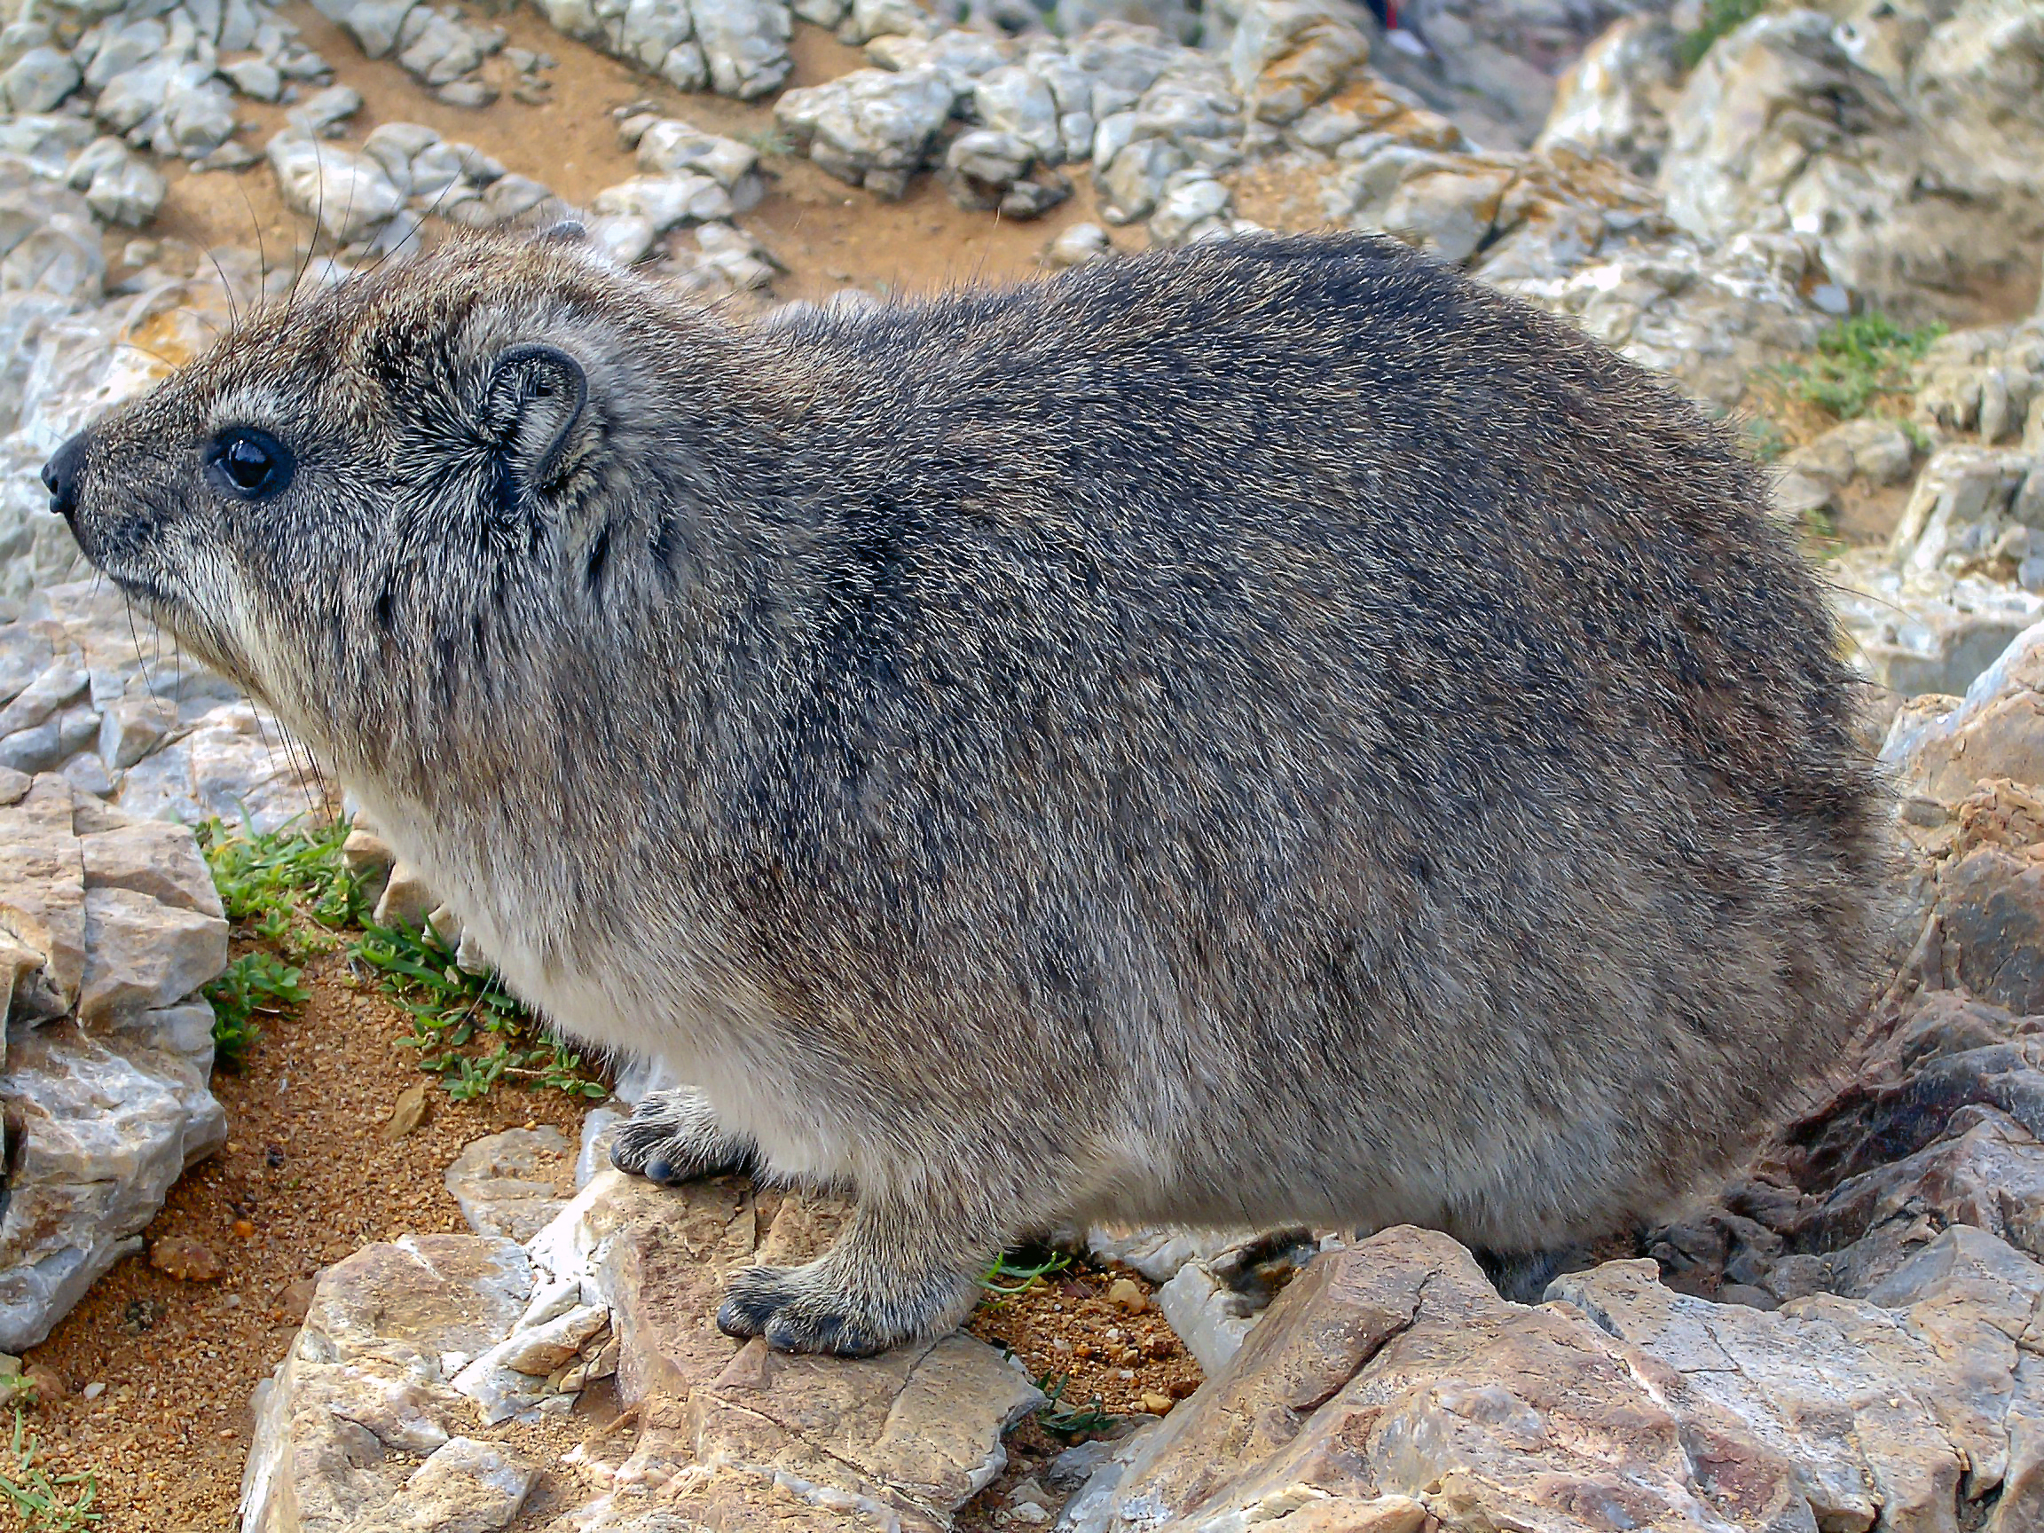
The Net who Cried Hyrax
Real Time Rock Hyrax detection and classification
Using Keras and TensorFlow
Oded Kalev, Noa Simon, Noa Rahamim

Slide 2
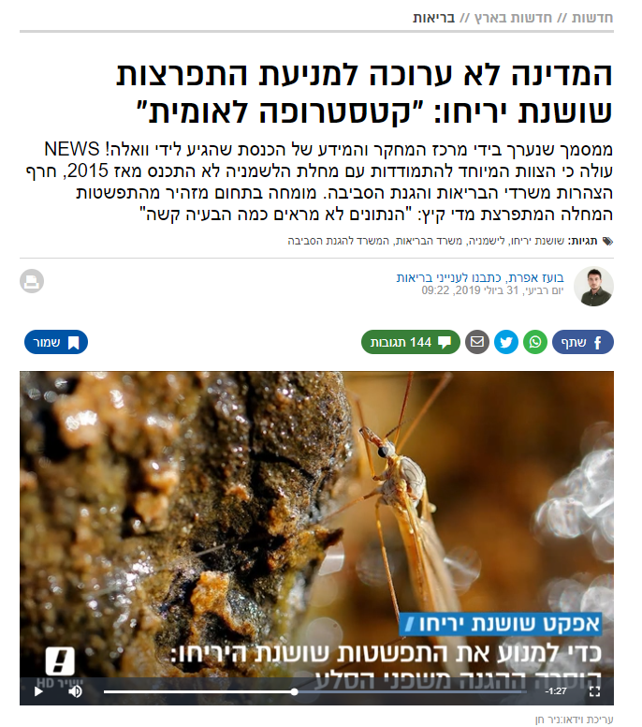
אודותינו
problem
Rock Hyraxes are main carriers of Leishmania
Phlebotomus pass this disease to humans
Efforts are made to prevent the disease from spreading

Slide 3


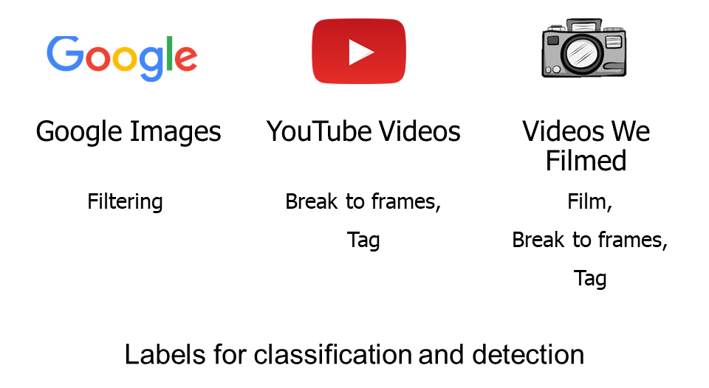
Building a data set turned out to be a non-trivial task

Slide 4

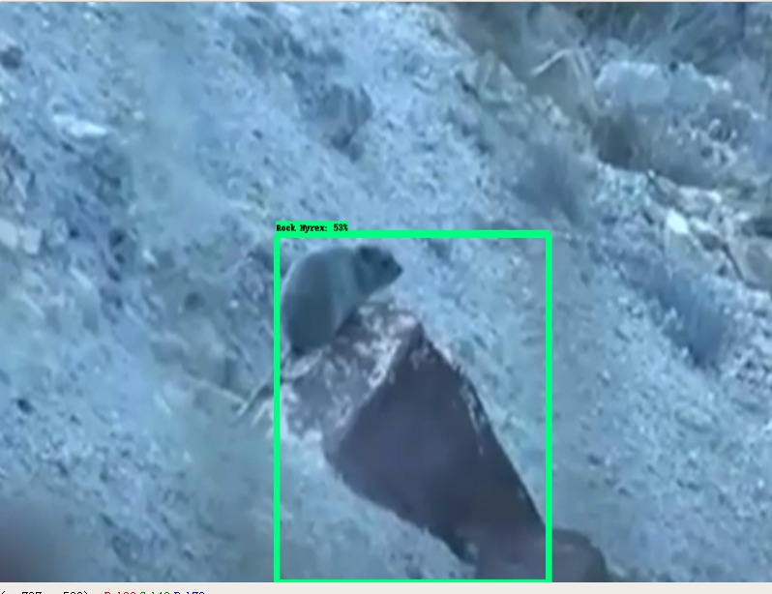
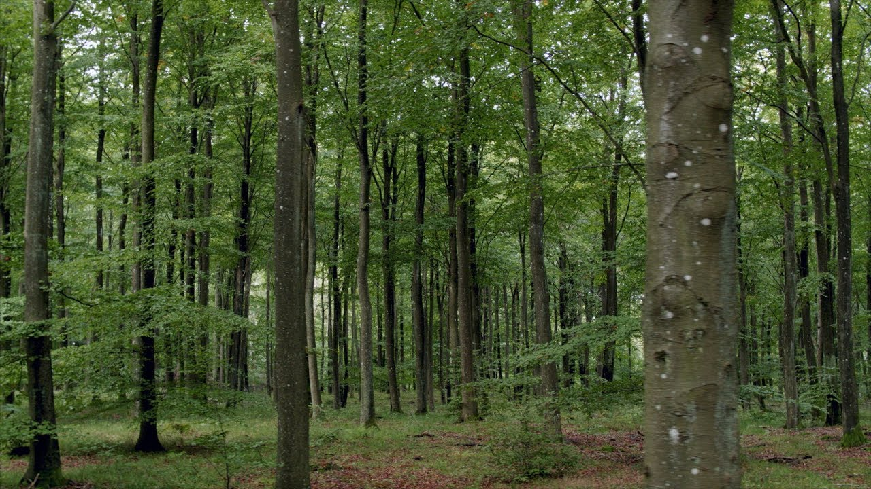
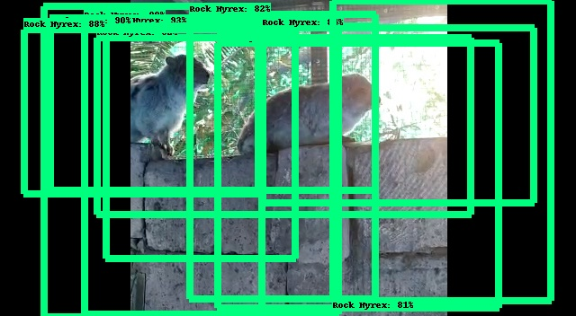
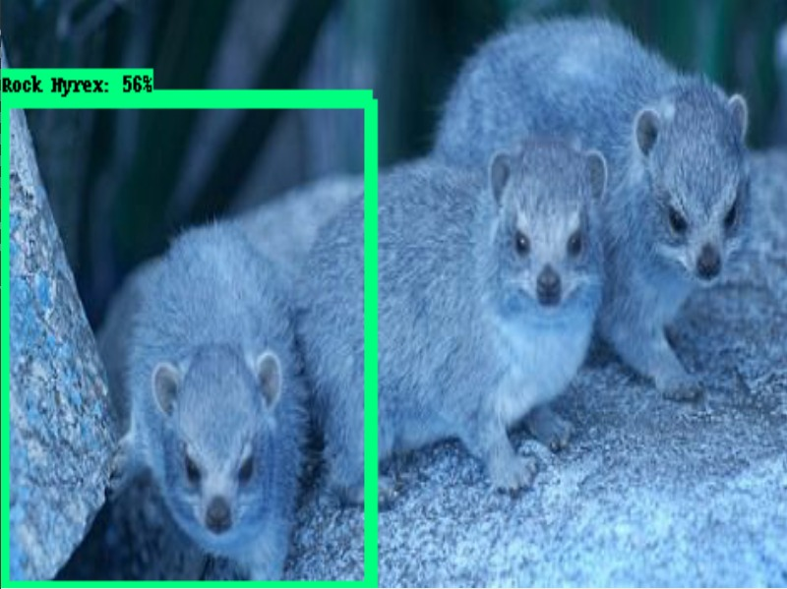
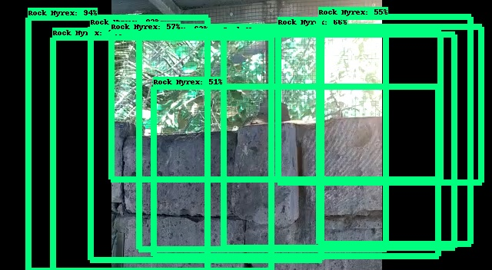
detection
Detection
TensorFlow ObjectDetectionAPI
Using SSD mobileNetV1 pre trained on COCO dataset
It was more than we needed…

Slide 5
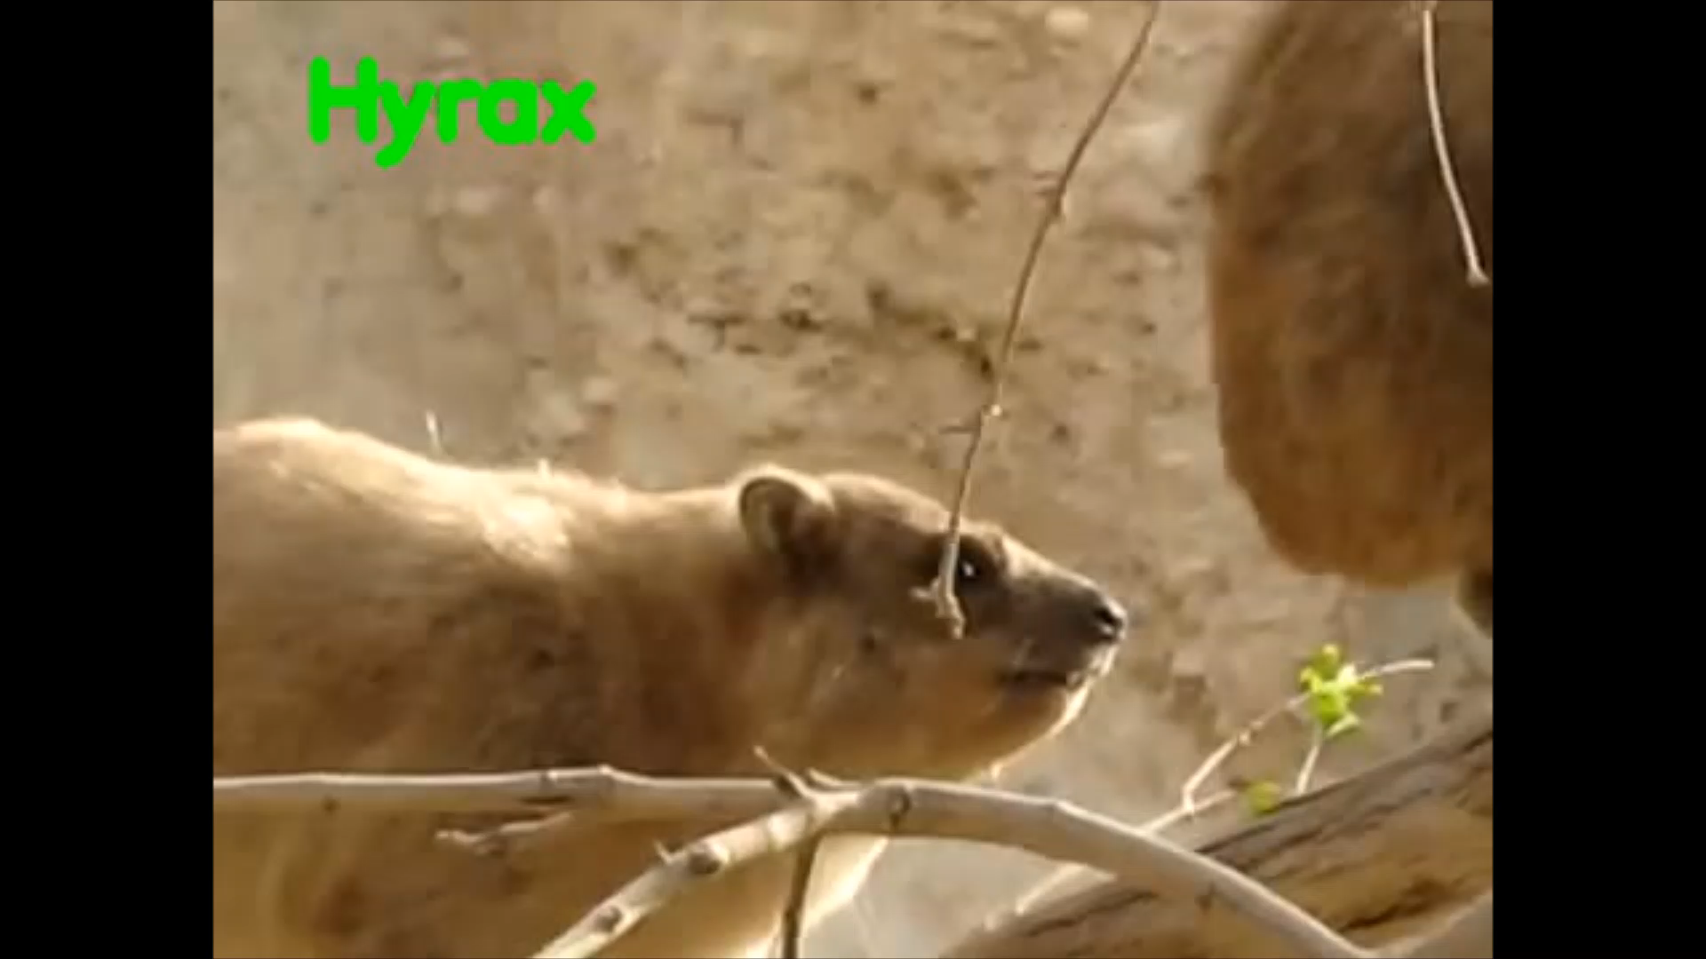
classification
Keras implementation of InceptionV3
Pre trained on ImageNet
Balanced data, between and within labels
Future improvements

Slide 6
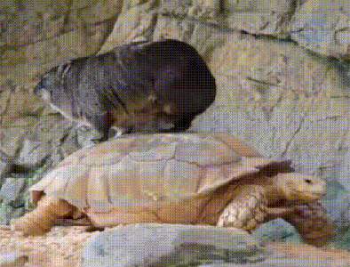
Questions?
Oded Kalev, Noa Simon, Noa Rahamim

